Slide 1

CubeSat -Control Preliminary Design Review
November 8, 2024
Ben Sherman
Trace Shafer
Lauric Brown
Micah Gifford
Notes:
title slide

Slide 2
PDR Overview
Attitude Control Subsystem Description
Ejection Timeline
Orbit Timeline
Design Criteria
Actuators
Reaction Wheels
Magnetorquers
Sensors
Star Trackers
Sun Sensors
IMU
Magnetometer
Control System
Control Diagram
Control Code
Board Layout
Control Weight
Power Consumption
Risk Mitigation
Reference Frames
ICRF Coordinates
Preliminary Subsystem Analysis
Gantt Chart
Budget/Cost Estimate
Notes:
Trace

Slide 3
Attitude Control System (ACS) Design Description
Stakeholders: Utah NASA Space Grant Consortium, Utah Division of Water Resources
Sponsors: RAM, PTC, Washington County Water Conservancy District
Design Statement: Design, prototype, and evaluate attitude control system to point at a set location on Earth while taking a photo from low Earth orbit.
Notes:
Trace

Slide 4
Attitude Control System (ACS) Description
Our CubeSat's ACS is designed to stabilize and precisely orient the satellite in space.
After launch, magnetorquers are used to stop any tumbling by interacting with Earth's magnetic field.
Once stabilized, reaction wheels provide fine control to point the CubeSat at specific targets, such as Utah, for photography.
The primary attitude sensing is handled by the star tracker, with sun sensors as a backup.
Additional data from the IMU and magnetometer ensure real-time attitude determination and accurate control throughout the mission.
Notes:
Ben

Slide 5
Design Criteria
Requirements:
2 year life
Must be able to use ACS to detumble after ejection
Must be able to track a point on Earth while a photo is being taken
Loads:
Must withstand random vibration of 10 Grms 1 min per axis
Must withstand bakeout of 100C for 24 hours
Estimated temperature cycling –25C to 25C
Materials concerned about:
Aluminum 6061
Reaction Wheel Glass Bearings
Electronic component temperature allowable: Derated from 125C
Power, current, and voltage for all electric components will be also be derated.
Power: 50-70%
Current: 50-75%
Voltage: 50-80%
Notes:
Ben

Slide 6
Software/Mechanical
Estimate lines of code:
Drivers: 5 * 500 = 2500
Control Loop: 1000
Mechanical interfaces: All parts will be attached to a PCB board except for the reaction wheels. PCB board will be attached by standoffs on the board. Reaction wheel aluminum frame will also be bolted directly to the frame, the motors will be bolted to the frame.
Electrical interfaces: Motor will connect to the driver using ribbons, we will get data from the star tracker and sun sensors via the command bus. The rest will be soldered directly to PCB board.
Notes:
Ben

Slide 7
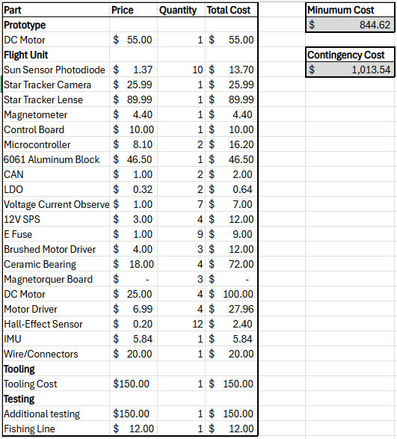
Budget/Cost Estimate
Budget: $1500
Notes:
Trace

Slide 8
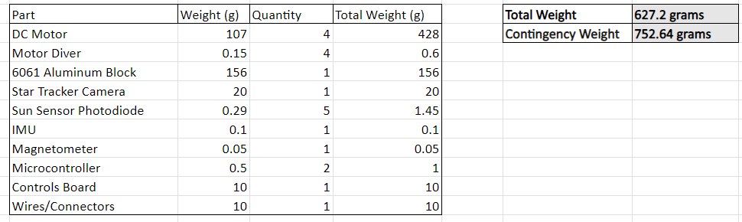
Control Weight
Notes:
Ben

Slide 9
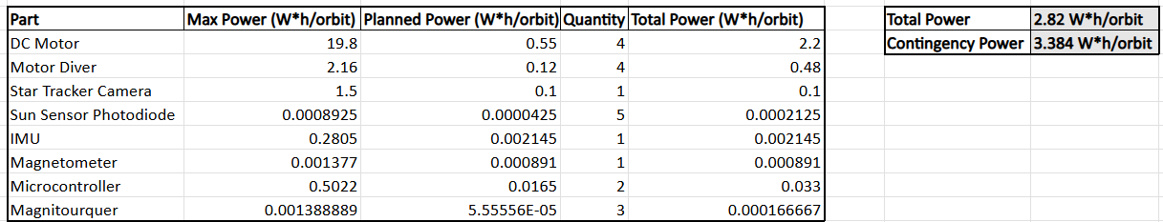
Power Consumption
Notes:
Ben

Slide 10
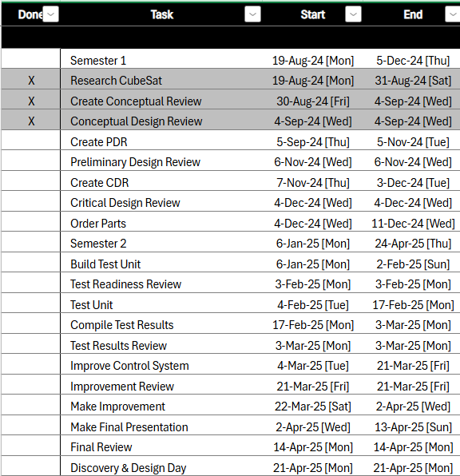
Schedule via a Gannt chart
Control Gannt Chart
Notes:
Trace

Slide 11
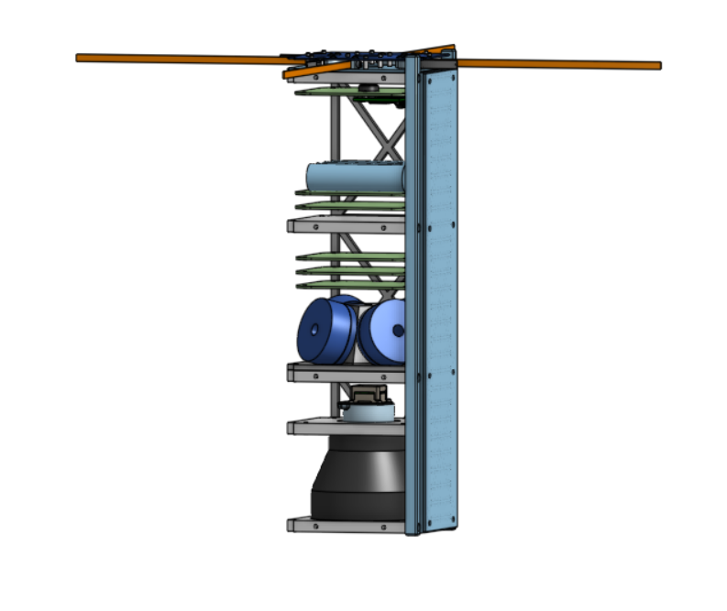
Control System
Star Tracker
Magnetorquers x4
Sun Sensor x4
Control Board
Reaction Wheels
Notes:
Ben

Slide 12
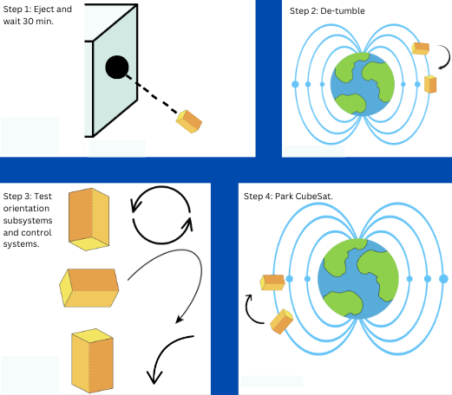
Ejection Timeline - Diagram
Notes:
Lauric

Slide 13
Ejection Timeline
Wait till command says to wake up (~30 min).
Use IMU, magnetometer, and magnetorquer to align CubeSat with Earth's magnetic field.
Run start up code to help fine tune the gains of the control system.
Use IMU, magnetometer, star tracker, and reaction wheels to park the CubeSat.
Move to orbit timeline.
Notes:
Lauric

Slide 14
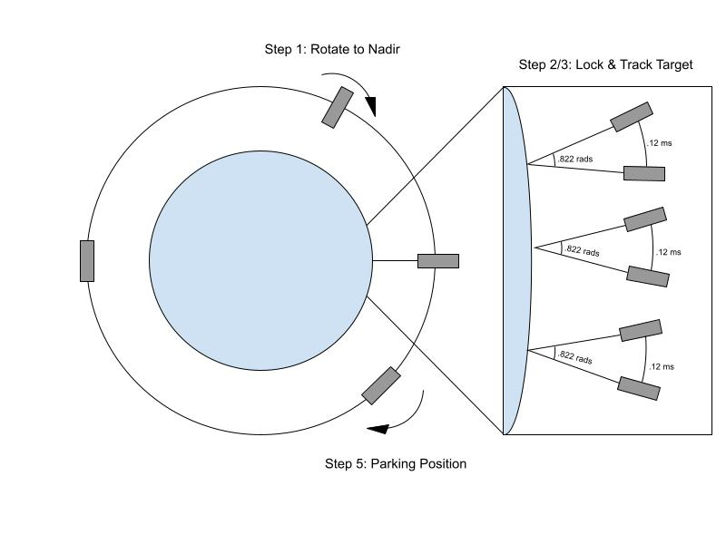
Orbit Timeline - Diagram
Notes:
Micah

Slide 15
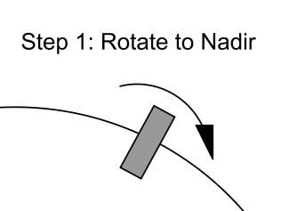
Orbit Timeline - Step 1
1 minute before the 1st photo is taken (star tracker will be able to know location) the reaction wheels will rotate the CubeSat from its parked orientation to nadir using the IMU and magnetometer.
Notes:
9.49 deg (for 600km altitude)
Micah

Slide 16
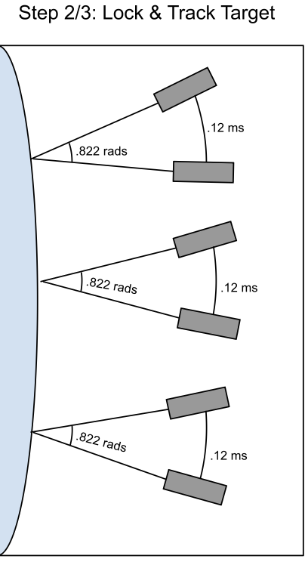







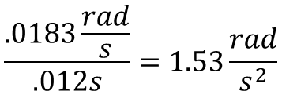
Orbit Timeline - Step 2
At an altitude of 400 km the CubeSat will track the position for 12 ms (time to take thermal IR image) using the reaction wheels while the CubeSat is traveling at a speed of 7600 m/s. During the photo the CubeSat had traveled 91.2 m.
That means the CubeSat will need to rotate 0.228 mradians
At a speed of 0.0183 rad/s
At an acceleration of 1.53rad/s^2
Notes:
title slide
Micah

Slide 17
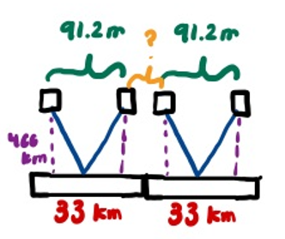





Orbit Timeline - Step 3
33km
33km
33km
42km
CubeSat
The swath length and width is 33km x 42 km.
The radius of the earth is 6371 km, and the CubeSat will be 400 km above Earth, so a total radius 6771 km.
Therefore the arc length will be, meaning that the distance that it travels before the next picture is taken is: 35.1 km
After taking the first picture, we will have a 4.62 second window before the next photo is taken.
At a speed of 0.000049 rad/s
Notes:
Micah

Slide 18
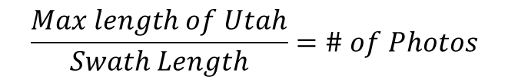
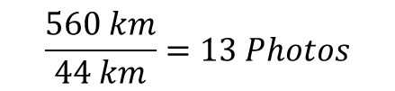

Orbit Timeline - Step 4
Repeat steps 2 and 3 till all photos have been taken in about 1 minute.
Notes:
Micah

Slide 19
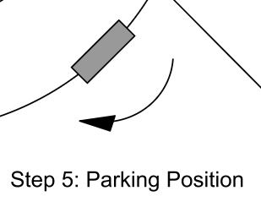
Orbit Timeline - Step 5
Use reaction wheels, star tracker, IMU, and magnetometer to move CubeSat back into its parking orientation.
Notes:
Micah

Slide 20
Specifications
Status | Metric | Units | Acceptable Values | Calculated Values
F | Sun sensor (Response Time) | Milliseconds | x<10 | 6e-5
F | IMU (Accelerometer Range) | Gravitational Force | -16<x<16 | In datasheet, and go up to acceptable value
F | Magnetometer (Range to cover Earth's magnetic field) | Microteslas | 20<x<100000 | Datasheet has acceptable values
F | Magnetic Dipole Moment (Magnetorquers) | Ampere-square meters | 0.1<x<10 | 0.128
F | FOV (Star Tracker Camera) | Degrees | 5<x<40 (Camera) 10<x<200 (Additional Lenses) | 40
Notes:
Trace

Slide 21
Specifications – Cont.
Status | Metric | Units | Acceptable Values | Calculated Values
F | Angular Velocity | rad/s | 0.0017<x<0.017 | 0.0183
F | Pointing Accuracy | Degrees | 0.1<x<1 | 0.8662
F | Rotating Accuracy | milliradians | 0.1<x<1 | 0.228
F | Power Consumption (Reaction Wheels) | Watts | x<6 | 4
F | Operational Temperature Range | Celsius | -40<x<85
F | Cost | Dollars | x<1500 | 1013.54
F | Weight | Grams | x<2500 | 628
Notes:
Trace

Slide 22
Actuators
Reaction Wheels
Magnetorquer
Notes:
title slide

Slide 23
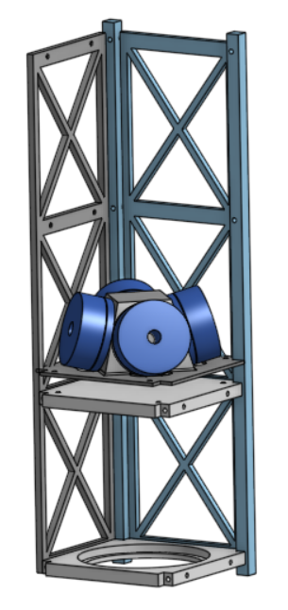
Reaction Wheel
For precise control of the CubeSat’s orientation.
Accelerating the motor in one direction accelerates the CubeSat in the opposite direction.
All 4 motors will simultaneously work together but with different contributions.
The control algorithm decide what the "optimal" way is to do that is.
Will allow us to point our CubeSat with accuracy of 0.8662 degrees
See MATLAB code for pointing accuracy calculations
Need to have pointing accuracy of at least 100m.
Redundancy: In this configuration only 3 motors are required so if one goes out it will function the same.
Notes:
Ben

Slide 24
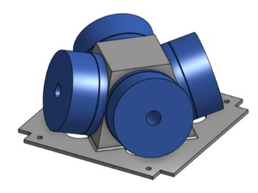
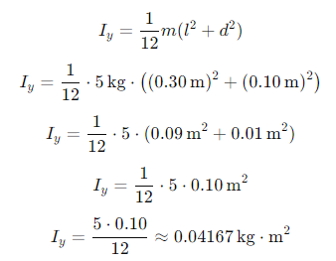
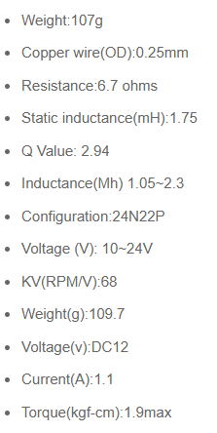

Reaction Wheel
Mass moment of inertia about y-axis of CubeSat:
Max Torque when tracking point.
Notes:
Ben

Slide 25
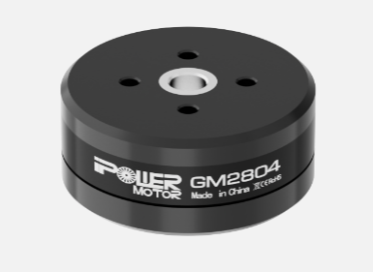
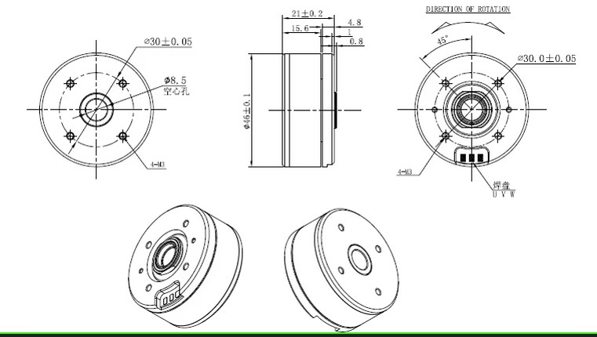
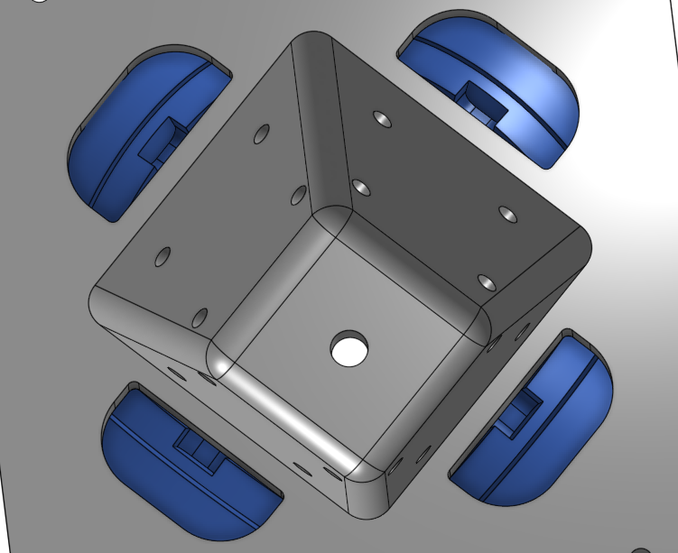
Preliminary Subsystem Design – Reaction Wheel
4- GBM4008H-150T Gimbal Motors 112 g each
Max Torque 1.9 kgf-cm
Voltage: 12V
12- Hall Effect Sensors
10.909 degrees between each sensor
4- MCT8315Z0HRRYR Brushless Motor Drivers
Operating Temp: -40C to 125C
Max PWM frequency: 200 kHz
1- 6061 Aluminum Frame (Machined in house) 152 g
Operating Temp: -180C to 260C
Key interfaces: Control Board, Power
Design margins: Max torque required 33mNm
Motor can provide 186mNm
Notes:
Ben

Slide 26

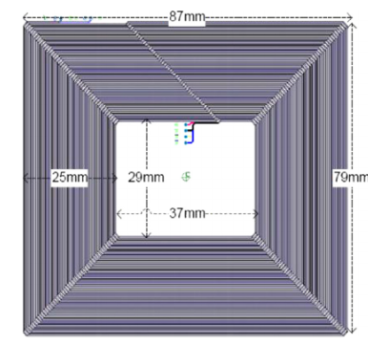

Magnetorquers
Used for momentum dumping and detumbling using the Earth's magnetic field.
Electromagnets that interact with Earth’s magnetic field to produce a torque
Notes:
https://www.researchgate.net/publication/259509038_Innovative_power_management_attitude_determination_and_control_tile_for_CubeSat_standard_NanoSatellites
https://www.researchgate.net/publication/357488533_Optimized_Design_and_Analysis_of_Printed_Magnetorquer_for_a_3-U_Nano-Satellite -American Society of Civil Engineers
Ben

Slide 27
Preliminary Subsystem Design - Magnetorquers
3 Magnetorquers
2 X-Z on Solar Panel PCB
2 Y-Z on Solar Panel PCB
1 X-Y on Control PCB
Key interfaces: Control Board, Magnetometer
If one of the magnetorquers goes out we will have a pack up magnetorquer as well as the reaction wheels can step in and help
Examples of it being done
Journal of Aerospace Engineering
Acta Astronautica
Magnetorquer on all 4 long sides
Magnetorquer
Notes:
https://www.researchgate.net/publication/259509038_Innovative_power_management_attitude_determination_and_control_tile_for_CubeSat_standard_NanoSatellites
https://www.researchgate.net/publication/357488533_Optimized_Design_and_Analysis_of_Printed_Magnetorquer_for_a_3-U_Nano-Satellite-American Society of Civil Engineers
Ben

Slide 28
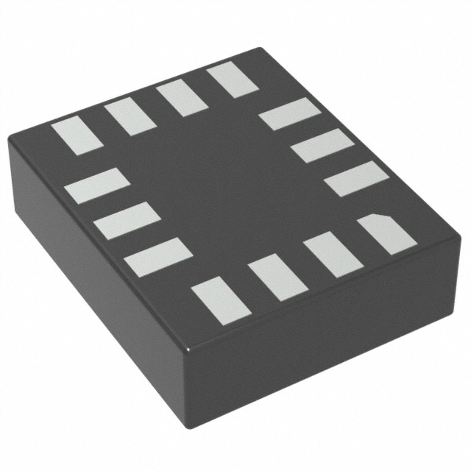
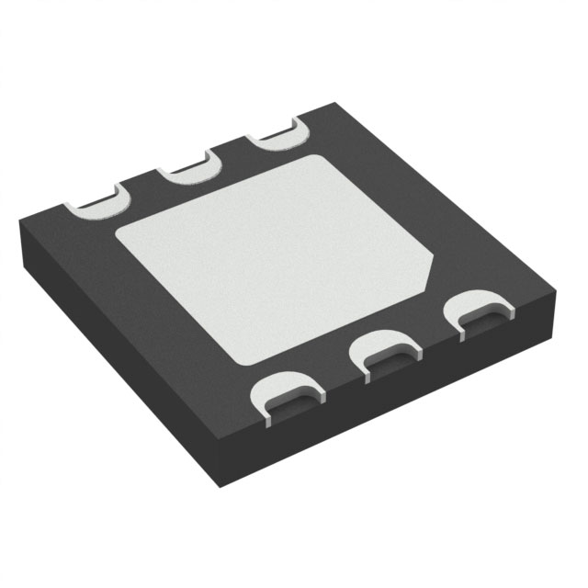
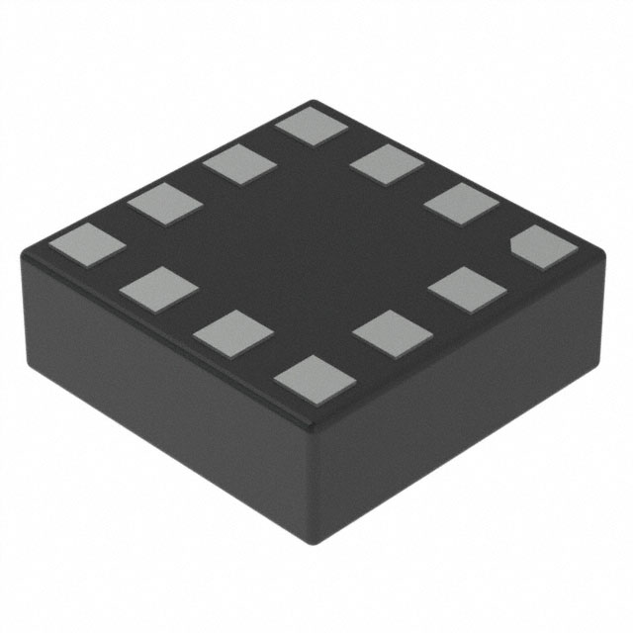
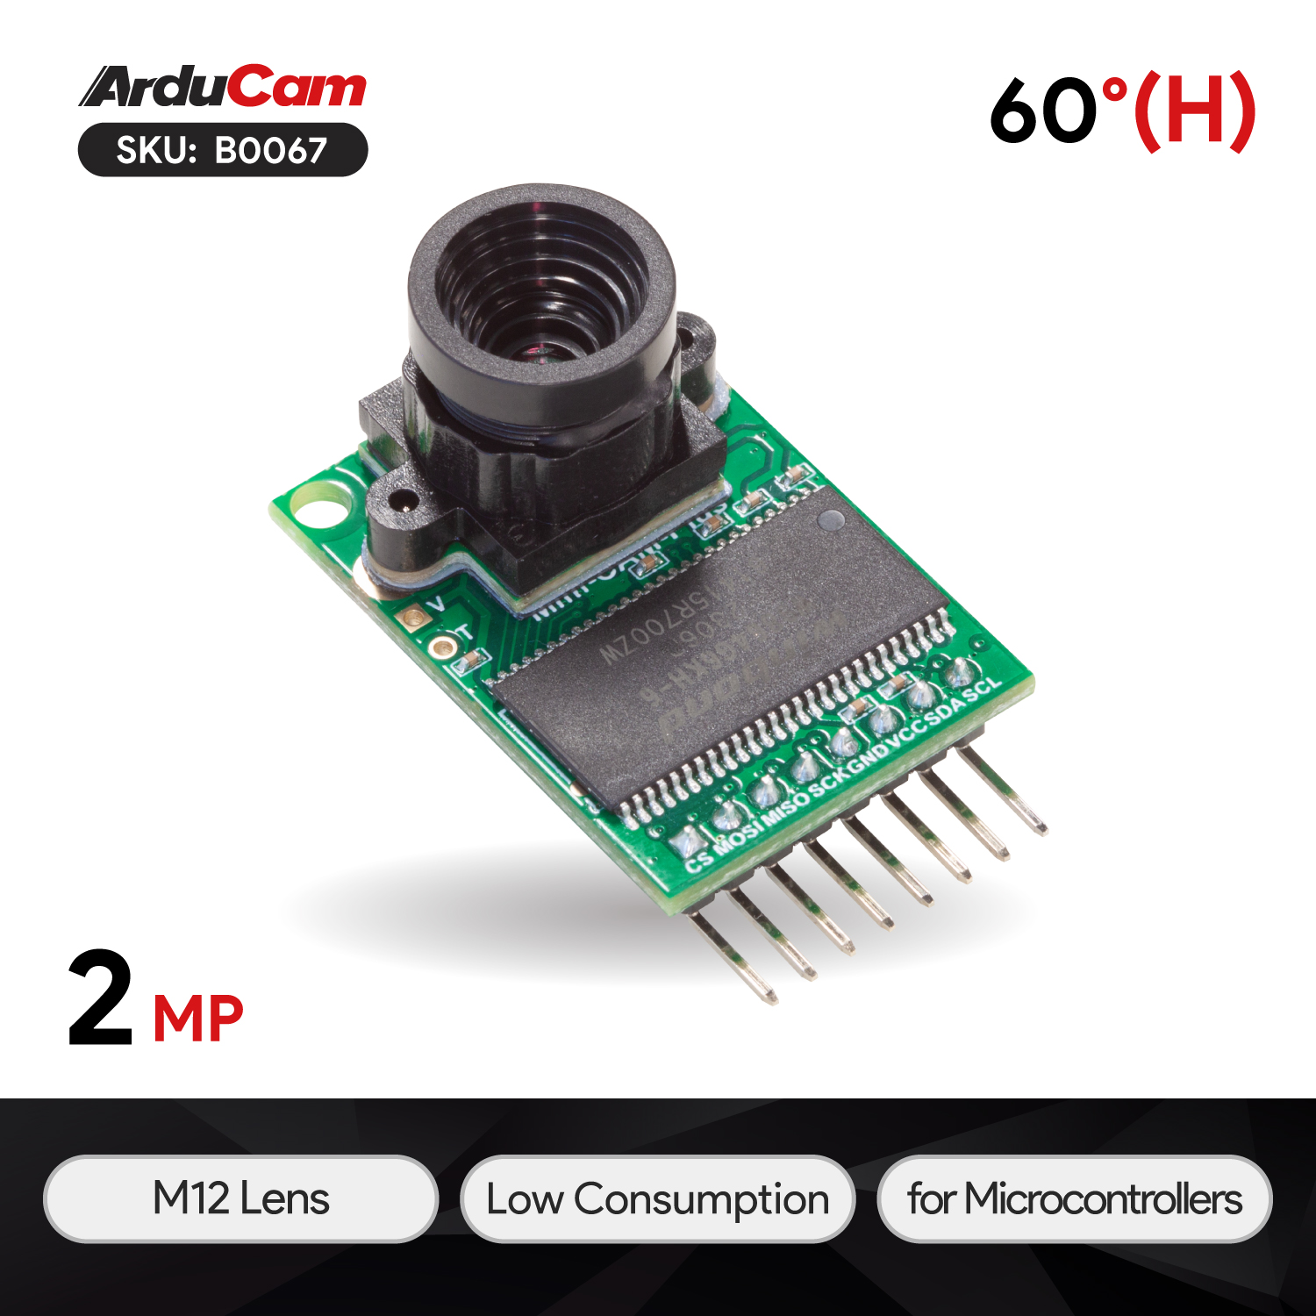
Sensors
Sun Sensor
IMU
IMU
Magnetometer
Star Tracker
Sun Sensors
Magnetometer
Star Tracker
Notes:
title slide

Slide 29
Preliminary Subsystem Design - Sensors
Star Tracker
Sun Sensor x4
IMU x2
Magnetometer x2
Notes:
Trace

Slide 30
Preliminary Subsystem Design - Sensors
Industry Standard Frequency: 100Hz
Star Tracker: For high-precision attitude determination using star fields
40 deg lens
2MP Image Sensor
Operating Temp: –10C to 55C
Goal update every 250ms (4Hz)
4 Sun Sensors (K857PE)(Redundant): For determining the Sun's position
One 4 quadrant photodiode on each long side of the CubeSat
Operating Temp: –40C to 110C
Max Frequency 1kHz
IMU (LSM6DSOXTR): For measuring angular velocity and acceleration of CubeSat
Operating Temp: -40C to 85C
Max Frequency 6kHz
Magnetometer (LIS3MDLTR): For measuring the Earth's magnetic field
Operating Temp: -40C to 85C
Max Frequency 400Hz
Notes:
Preliminary drawings/schematics
Key interfaces
Design margins
Identify what part of subsystem is redundant and what is not
Ben

Slide 31
Control System
Linear Quadratic Regulator (LQR)
Goal is to minimize the cost function
Tune gains of cost function to get best performance
Help us not over use the reaction wheels
Extended Kalman Filter (EKF)
Re-linearize the system every time you update the estimates
Combines sensor readings with different sampling rates
Proportional Integral Derivative (PID)
Will help control the reaction wheels by using the hall effect sensor to give feedback
Notes:
Ben

Slide 32
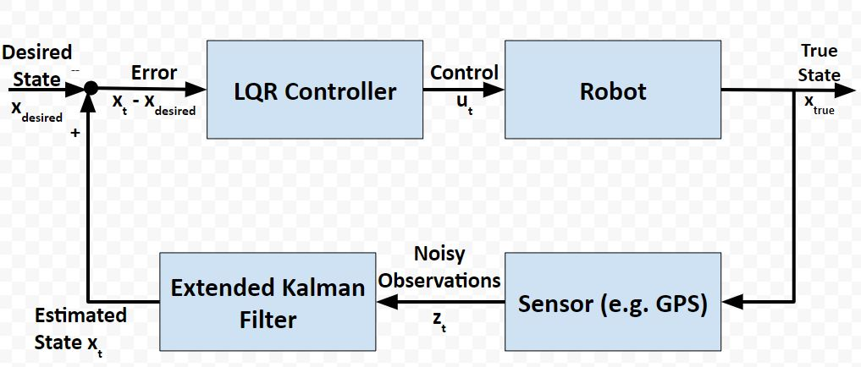
Control Diagram
7 States:
4 Quaternions (J-2000)
3 Angular Velocity (Body Frame x,y,z)
CubeSat
Notes:
Ben

Slide 33







Control Equations
LQR:
EKF:
PID:
Gain
Kalman Gain
Riccatti Equation
Riccatti Equation
Cost Function
Notes:
Ben

Slide 34
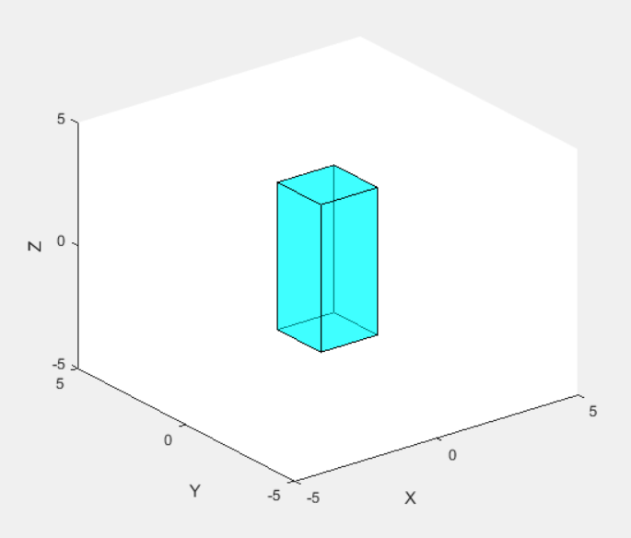
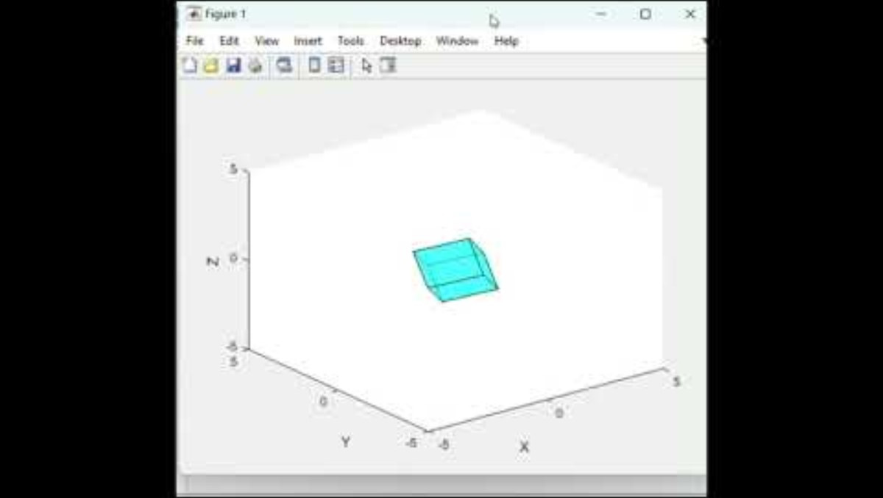
Control Code
Current simulation we have showing the control algorithm moving the CubeSat.
Notes:
Ben

Slide 35
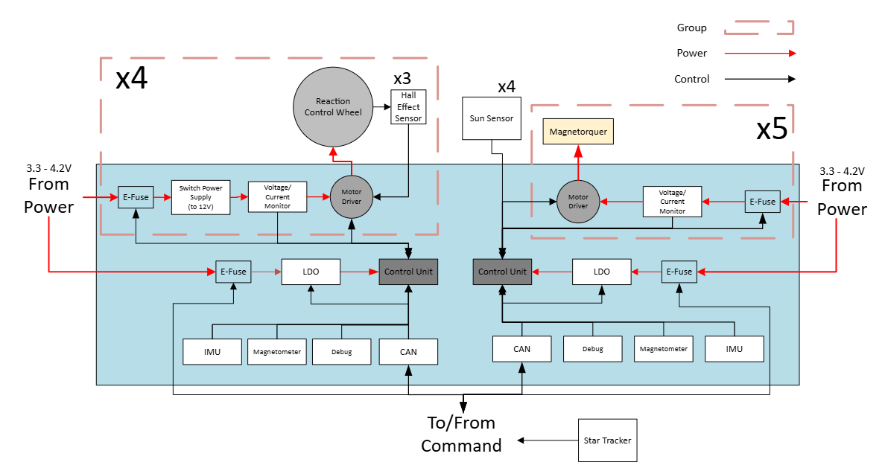
Control Board Layout
Notes:
Ben Drawing.vsdx

Slide 36
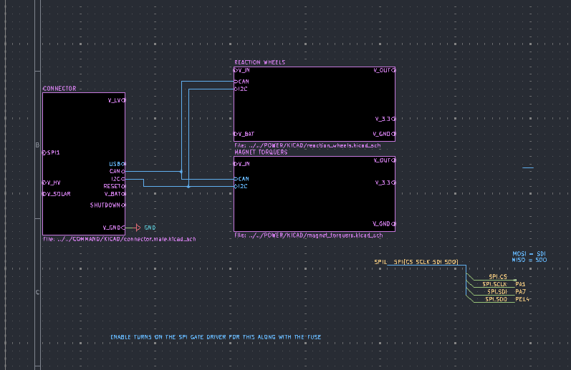
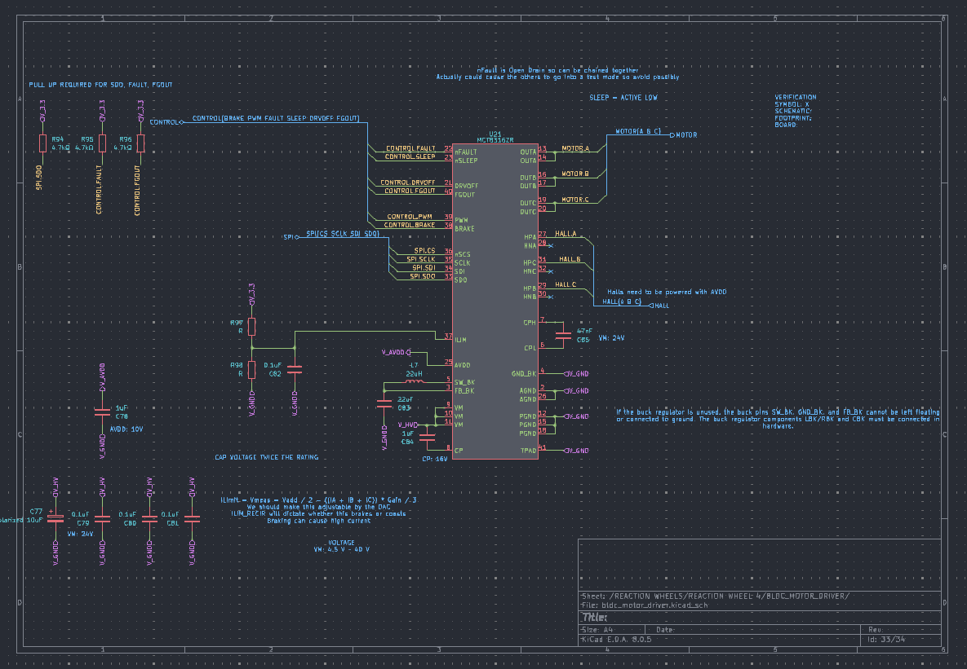
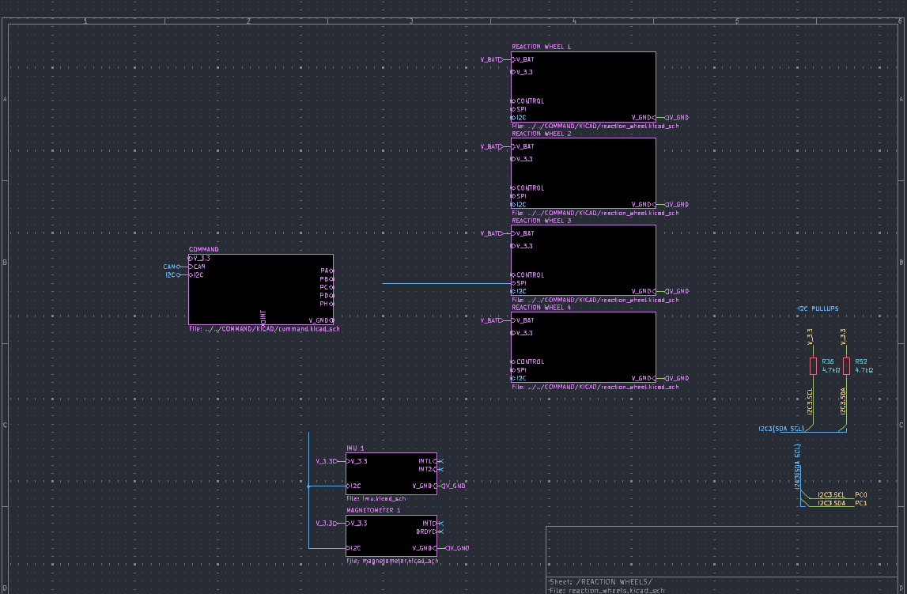
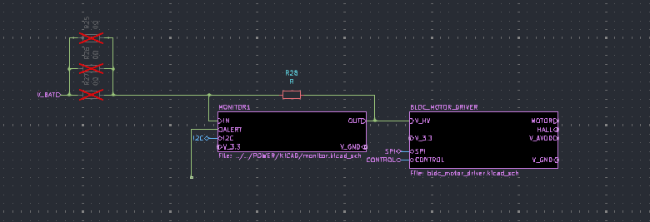
Control Board Schematic
Notes:
Ben

Slide 37
Reaction Wheel: Risk and Risk Mitigation
The Risk:
One or more reaction wheels fails.
Identification:
Motor Driver RPM output / Current Monitoring.
Solution Options:
In the event one reaction wheel fails, we retain full control using the remaining three wheels.
If two or three reaction wheels fail, we retain full degrees of freedom as long as we have one reaction wheel and three magnetorquers.
Risk Mitigation:
Using Brushless DC motor along with non-metallic bearings.
Notes:
Lauric

Slide 38
Magnetorquer: Risk and Risk Mitigation
The Risk:
One or more magnetorquer fails.
Identification:
Adaptive Control Failure Identification / Current Monitoring
Solution Options:
We are able to use our reaction wheels to control all degrees of freedom in the case that any of our magnetorquers fail.
Mitigation:
We will have magnetorquers inside of every solar panel PCB so we have dual redundancy.
Notes:
Lauric

Slide 39
Magnetometer: Risk and Risk Mitigation
The Risk:
Nearby electronic components or CubeSat actuators (e.g., reaction wheels, magnetorquers) generate magnetic fields that can interfere with the magnetometer’s readings.
Identification:
Review CubeSat component layout to identify sources of magnetic interference within the satellite.
Solution Options:
Increase distance between the magnetometer and other magnetic field sources. Implement code to facture out interference.
Risk Mitigation:
There are going to be two magnetometers to help improve the accuracy.
Notes:
Lauric

Slide 40
Star Tracker: Risk and Risk Mitigation
The Risk:
Star Tracker not determining correct orientation of the CubeSat.
Identification:
The pictures are blank. Can't identify a 4th star using the 3 we choose.
Solution Options:
Re-upload new code through ground communications.
Risk Mitigation:
Sun sensors in place as back-up orientation.
Notes:
Lauric

Slide 41
Sun Sensor: Risk and Risk Mitigation
The Risk:
Direct exposure to sunlight may saturate the sensor, while deep shadowed regions may cause a loss of signal.
Identification:
Test the sensor’s response to various light intensities and shadows to assess saturation and signal loss.
Solution Options:
Positioning multiple sun sensors around the CubeSat increases the likelihood of always having one sensor with a valid signal.
Risk Mitigation:
Position multiple sun sensors on the CubeSat to maximize accuracy and availability in case of shadowing.
Notes:
Trace

Slide 42
IMU: Risk and Risk Mitigation
The Risk:
Noisy IMU signals may reduce the accuracy of CubeSat attitude determination when fusing IMU data with other sensors.
Identification:
Analyze IMU data for expected noise levels and potential data fusion issues with other sensors like star trackers or magnetometers.
Solution Options:
Apply Kalman filters or similar algorithms to reduce noise in IMU signals.
Risk Mitigation:
Implement Kalman or complementary filters to reduce the effect of noise and drift.
Notes:
Trace

Slide 43
Code(Algorithm): Risk and Risk Mitigation
The Risk:
Inefficient code may exceed memory limits or processing time, slowing or interrupting the control response.
Identification:
Analyze code for memory and CPU usage to ensure it operates within CubeSat hardware constraints.
Solution Options:
Profile and optimize resource-heavy operations, removing redundant calculations and implementing efficient data structures.
Risk Mitigation:
Design self-diagnostics for early identification of trends that indicate potential issues, such as increased processing time or rising memory usage.
Notes:
Trace

Slide 44
ICRF Coordinates
ICRF stands for International Celestial Reference Frame, and is mainly used for the navigation of the CubeSat because:
Accurate Navigation and Tracking: ICRF is a high-precision, stable reference frame based on the positions of distant quasars, which are nearly fixed relative to Earth. Using this frame helps in accurately determining and predicting the spacecraft's position and orientation in space over time.
Standardized Communication: ICRF is the standard reference system for astronomy and space science, allowing consistent communication and comparison of spacecraft position and orientation between different agencies and systems (like ground stations, tracking systems, etc.).
Global Alignment: As CubeSats orbit Earth and interact with other spacecraft or celestial objects, it’s essential to have a frame that remains globally aligned. ICRF provides that global consistency because it is independent of Earth's rotation, which can vary slightly over time due to phenomena like polar motion.
We are using ICRF because with a star tracker we can use the ICRF to determine their attitude (orientation in space). Star trackers compare images of known stars to the ICRF catalog to accurately calculate the CubeSat’s orientation, which is critical for navigation, scientific observations, and communication alignment.
Notes:
Trace

Slide 45
ICRF Coordinates, Calculations
ICRF coordinates frames can be found using Julian's date calculations.
Julians Date: Julian date calculations are used in ICRF (International Celestial Reference Frame) coordinate conversions to account for the precise timing needed to determine celestial positions. Since celestial bodies and spacecraft positions change continuously, converting from Earth-based coordinate systems (like ECEF) to space-based ones (like ICRF) requires exact dates and times.
Comparing the calculations to MATLAB Spice toolkit, the calculations are pretty close, being off by about three meters.
Doing different dates and times provided similar results.
The hand calculations could have been skipped, but this allowed to check if the Spice toolkit was correct.
Notes:
Trace

Slide 46
Questions, Comments, Concerns?
Notes:
Everyone

